Slide 1

Reflection
Time to be…

Slide 2
Keeping Happy and Safe

Slide 3



This week’s big question…
How do we know what is normal?

Slide 4
This week’s big question…
How do we know when we are safe?

Slide 5


Slide 6
Keeping safe in school…
Friend
Teacher
Learning Support Assistant
Mrs Roberts
Any adult

Slide 7
Keeping safe in school…
Who else knows about keeping safe?

Slide 8

Buddy…

Slide 9
Buddy says…
Bullying is when children are mean
and unkind to each other, not just once
but again and again. They might push
a child around, leave them out, or send
nasty texts or emails. This can hurt on
the inside or on the outside, and
often both.

Slide 10

Buddy says…
Bullying is NOT OK.

Slide 11
Buddy says…
Neglect is when a parent or carer
does not look after a child properly.
They might not give them enough
food and drink, or the right kind of
clothing. It can also be when a child
is left on their own for too long.

Slide 12
Buddy says…
This is NOT OK.

Slide 13
Buddy says…
Physical abuse is when an adult
deliberately hurts a child's body. They might hit, kick, punch, bite or shake them. This may leave marks on the body such as cuts and bruises. It is not alright to be encouraged to fight with your brother or sister.

Slide 14
Buddy says…
This is NOT OK.

Slide 15
Buddy says…
Emotional abuse is when an adult hurts a
child's feelings. They might call them names, make fun of them or make a child feel bad about themselves.
This hurts children on the inside.
Seeing or hearing parents or carers hurting
each other can also make a child feel bad.

Slide 16
Buddy says…
This is NOT OK.

Slide 17
Buddy says…
Know the underwear rule. The underwear rule is a simple way to understand how you can stay safe. By learning five easy sayings you can help yourself and others, perhaps a younger brother or sister stay safe.

Slide 18


Slide 19
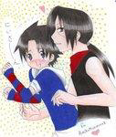

Say when you do not like something.
I don’t like being tickled.
You are in charge of your own body.
What can you do if you are made to feel uncomfortable?

Slide 20
Buddy says…
Abuse is never your fault.
Someone might say it is,
but abuse is NOT OK and
it needs to stop.

Slide 21
Who can you talk to in school?
Friend
Teacher
Learning Support Assistant
Mrs Roberts
Any adult

Slide 22
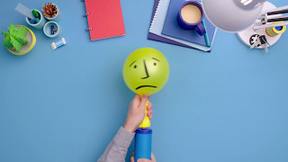
Childline
Children and young people can contact ChildLine 24 hours a day,
seven days a week.
It’s free and confidential
Remember the number: 0800 1111
Remember the site: www.childline.org.uk

Slide 23

Reflection…

Slide 24

‘Let Your Light Shine’
Matthew 5:16
Notes:
Ava

